Slide 1
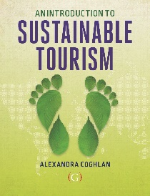
GOVERNANCE For sustainable tourism
Lecture 5
© Alexandra Coghlan 2019 Introduction to Sustainable Tourism

Slide 2
How do we drive sustainability? Is it from top down? Or from the bottom up?
The top-down approach – often starting out as a command and control governing approach which seeks stakeholder buy in to translate the rhetoric of sustainable tourism into practical, on the ground, outcomes.
Vs
The bottom up approach - where stakeholders seek to have on-the-ground concerns and actions taken up by policy makers, who are encouraged to consider the social, environmental as well as economic outcomes of their decision-making.
Or meeting in the middle…
© Alexandra Coghlan 2019 Introduction to Sustainable Tourism

Slide 3
Definition of governance
The Australian Governance Institute defines it in these terms:
Governance encompasses the system by which a state or organisation is controlled and operates, and the mechanisms by which it, and its people, are held to account. Ethics, risk management, compliance and administration are all elements of governance.
© Alexandra Coghlan 2019 Introduction to Sustainable Tourism

Slide 4
Where has “governance” come from?
In “New Right”, corporatist or neo-conservative agenda, who looks out for public good?
Governance is a stakeholder partnerships approach for decision-making where public good is involved.
Stakeholders in sustainable tourism development include:
national governments;
local governments with specific competence in tourism matters;
tourism establishments and tourism enterprises, including their associations;
institutions engaged in financing tourism projects;
tourism employees, tourism professionals and tourism consultants;
trade unions of tourism employees;
tourism education and training centers;
travellers, including business travellers, and visitors to tourism destinations, sites and attractions;
local populations and host communities at tourism destinations through their representatives;
other juridical and natural persons having stakes in tourism development including non-governmental organizations specializing in tourism and directly involved in tourism projects and the supply of tourism services.
(according to the UNWTO)
© Alexandra Coghlan 2019 Introduction to Sustainable Tourism

Slide 5
3 Principles of good governance
Transparency,
Accountability
Inclusiveness
© Alexandra Coghlan 2019 Introduction to Sustainable Tourism

Slide 6
Starting the governance process – basic questions to be addressed
What is the problem domain being addressed? Who are the stakeholders and who do they represent (are they inclusive)?
Who are the stakeholders and who do they represent (are they inclusive)? To what degree is agreement reached about how to act on the problem domain?
To what degree is agreement reached about how to act on the problem domain? What is the outcome and achievements of the partnership?
What is the outcome and achievements of the partnership?
© Alexandra Coghlan 2019 Introduction to Sustainable Tourism

Slide 7
Stages in governance
Problem setting: identifying key stakeholders and issues
Direction setting: identifying and sharing future collaborative interpretations; appreciating a sense of common purpose
Implementation (or empowerment stage) – institutionalising the shared meanings that emerge as the domain develops
© Alexandra Coghlan 2019 Introduction to Sustainable Tourism

Slide 8
Additional requirements to reach socially responsible action
Mutual benefits, which can sustain long-term relationships
Enlightened self-interest, where societal needs are acknowledged and considered over the long-term, rather than short-term.
Ethical awareness, in which a set of moral or social obligations are considered and valued as legitimate.
Power and responsibilities, where the person holding power recognises the responsibilities that come with it.
Enterprise defence, where the autonomy of various stakeholders is preserved.
© Alexandra Coghlan 2019 Introduction to Sustainable Tourism

Slide 9
Benefits & Costs
Supports democracy
Accesses those who will introduce change
Increases support for implementation
Pools knowledge and resources
Recognises non-economic values
More flexible, sensitive solutions
Limited representation
Conflict vs collaboration
Usually under-resourced
Blurred accountability
Uncertainty around outcomes
Disclosure of confidential commercial info.
Time consuming and costly
© Alexandra Coghlan 2019 Introduction to Sustainable Tourism

Slide 10
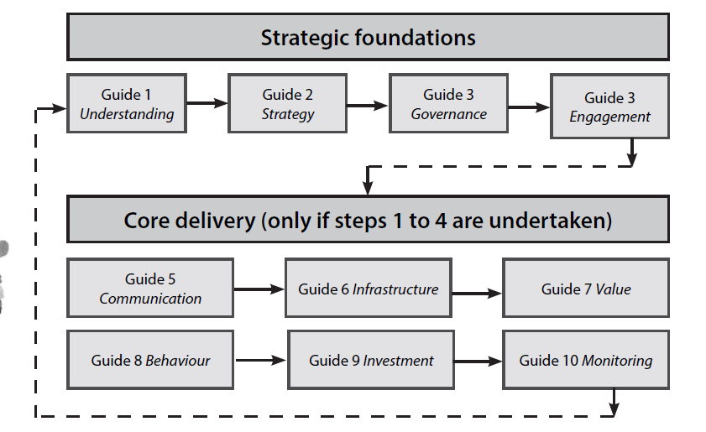
UNESCO tourism planning
lists governance as foundational
© Alexandra Coghlan 2019 Introduction to Sustainable Tourism

Slide 11
Some techniques for working with stakeholders
Round tables
Interest based negotiations
Appreciative Inquiry
© Alexandra Coghlan 2019 Introduction to Sustainable Tourism

Slide 12
Interest-based negotiations
Focuses on basic interests, rather than personal positions
Looks at all options for mutual gain
Uses objective criteria to settle differences of interest
Separates people from the problem
i.e. it’s continually asking “does this proposed action take you towards or away from your basic interest” until consensus is reached around a plan that suits everyone’s interests.
© Alexandra Coghlan 2019 Introduction to Sustainable Tourism

Slide 13
Moving from “positions” to “interests”
Interest-based negotiating relies on asking a lot of questions, rather than stating positions. Three types of questions are usually used:
Probing questions that ask for more information, e.g. what is it about this that concerns you most?
Clarifying questions that sharpen understanding, e.g. can you tell me more about what you meant when you used the word….?
Justifying questions that ask for evidence for the view expressed, e.g. can you tell me how you plan to achieve this?
© Alexandra Coghlan 2019 Introduction to Sustainable Tourism

Slide 14
An example in practice
© Alexandra Coghlan 2019 Introduction to Sustainable Tourism

Slide 15
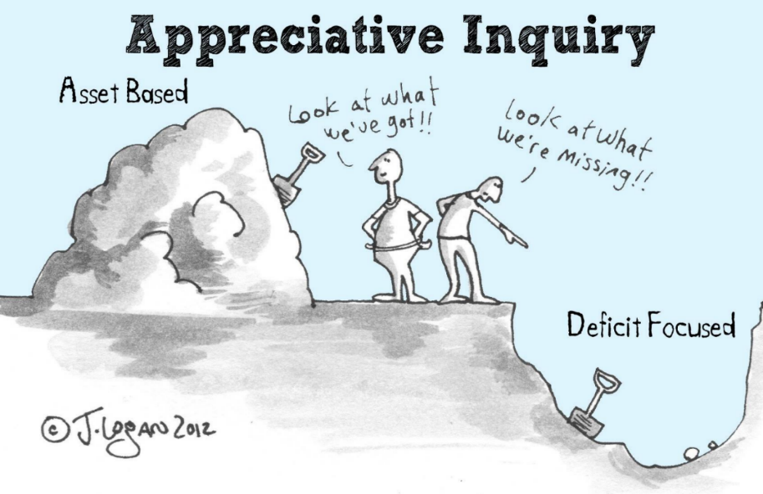
Appreciative Inquiry
What is working really well?
Why and how does it work?
How do we amplify and build on what has meaning, value, and energy?
Often used in community-based tourism development
© Alexandra Coghlan 2019 Introduction to Sustainable Tourism

Slide 16
Appreciative Inquiry process
Discovery
Strategic Context
Positive Core
Deliver
Dream
Structure
Implement
4-Step Cycle
Purpose
Vision
Design
Relationships & Organization
© Alexandra Coghlan 2019 Introduction to Sustainable Tourism

Slide 17
Challenges facing good governance
Tokenism
Group think
Skills, knowledge and experience
© Alexandra Coghlan 2019 Introduction to Sustainable Tourism

Slide 18
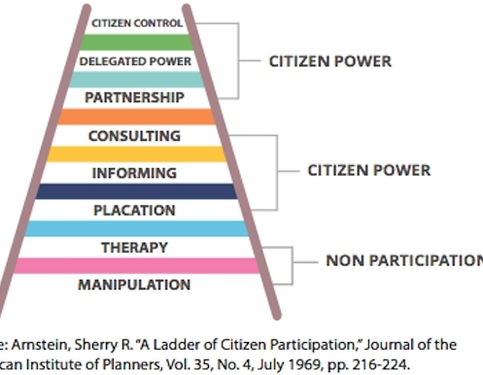
TOKENISM
Symbolic representation and engagement rather than actual inclusiveness…
© Alexandra Coghlan 2019 Introduction to Sustainable Tourism

Slide 19
Group think
When people in a group setting make irrational or non-optimal decisions so as to conform or because dissent is discouraged
Group members may self-censure from expressing doubts and judgments or disagreeing with the consensus.
Group members may also ignore any ethical or moral consequences in order to reach a consensus
© Alexandra Coghlan 2019 Introduction to Sustainable Tourism

Slide 20
Skills, knowledge and experience
The success of both the process and the decisions depends on having representatives of stakeholders with experience, skills and knowledge in carrying out good governance AND sustainable tourism development
Three types of knowledge are generally required:
explicit knowledge – codified knowledge about how collaborations function well, decisions are made, policies are created, etc.;
(ii) tacit knowledge – experience-based knowledge about the sustainability issues likely to arise through different tourism development scenarios;
(iii) embedded knowledge – knowledge about the type of community concerned, its values and norms.
© Alexandra Coghlan 2019 Introduction to Sustainable Tourism

Slide 21
Other forms of tourism partnerships
Sustainable tourism clusters
Can help build that knowledge and experience
Also useful to generate sustainability-solutions outside the governance context
Work best when:
Strong network ties that facilitate knowledge transfer
An openness to new members and a reflexive approach to practice
Cross-network interactions that provide members with new knowledge, ideas and technologies
A source of learning activities
A set of socio-cultural institutions that facilitate learning
© Alexandra Coghlan 2019 Introduction to Sustainable Tourism

